Slide 1
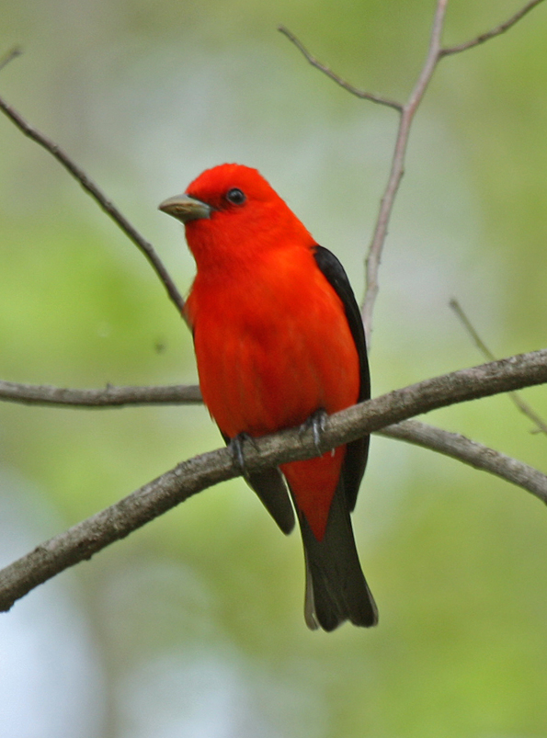
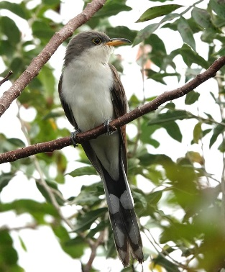
Applying hierarchical distance sampling in 'unmarked' to Iowa forest birds
Benjamin M. West and Stephen J. Dinsmore
Benjamin M. West

Slide 2
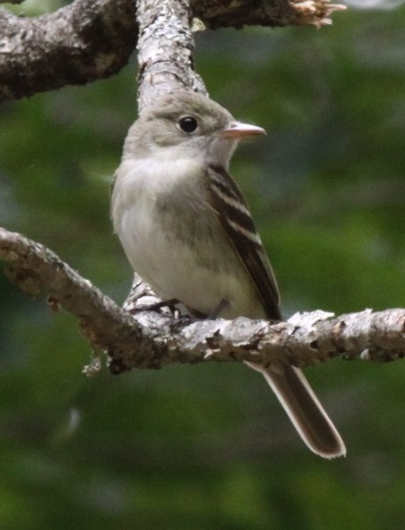
Study Objectives
Acadian Flycatcher
Estimate densities of bird species of conservation concern in south-central Iowa forests
Determine relationships between habitat characteristics and bird densities to potentially inform management

Slide 3
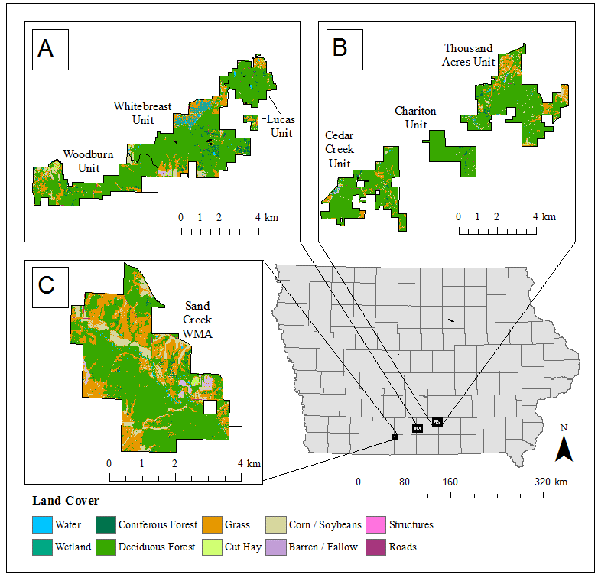
Study Area
Stephens Forest BCA
Thousand Acres BCA
Sand Creek
BCA

Slide 4
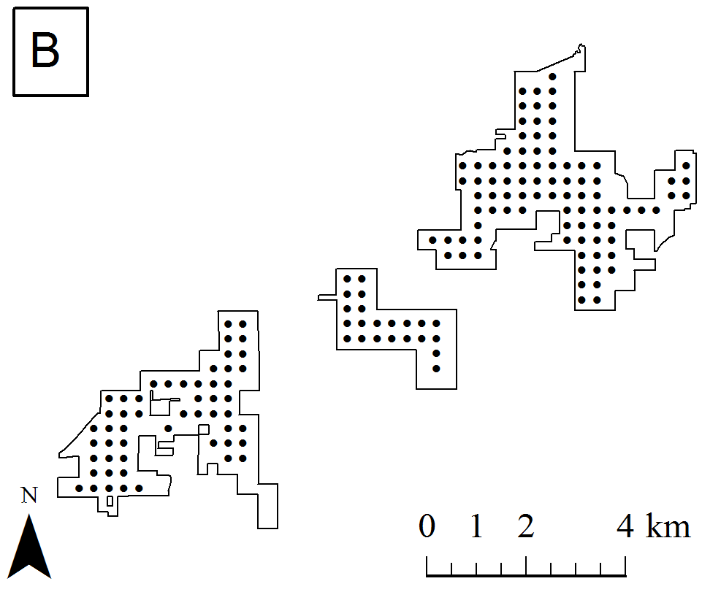
Bird Point Counts
Thousand Acres BCA
493 points
2016-2019
Two visits/year during breeding season

Slide 5
Bird Point Counts
Distance sampling
4 bins
100 m truncation
10 minutes
No visual only or known female observations
75-100 m
50-75 m
25-50 m
0-25 m
observer

Slide 6
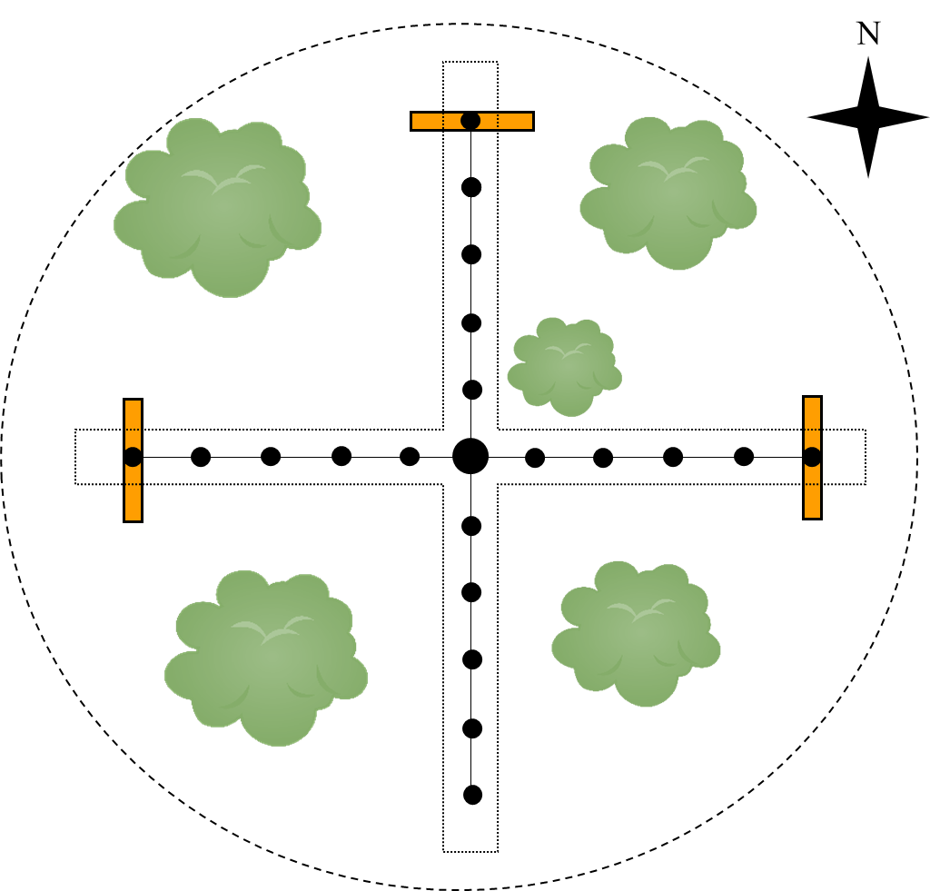
Vegetation Surveys
493 points (same as bird surveys)
July – August 2019
Forestry prism sample, ground cover, shrub stems

Slide 7
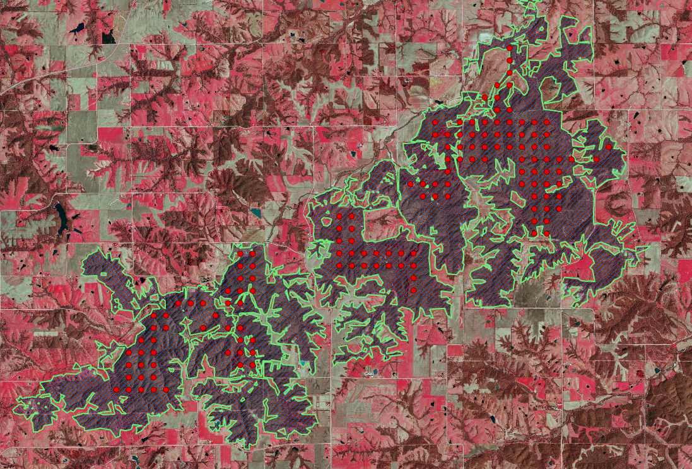
Landscape Scale Data
Cropscape data and ArcGIS used to estimate % forest cover within 1 and 10 km of point
Digitized 2016-2018 Iowa Spring Color Infrared Orthophotos to get forest patch boundaries (Cropscape as an initial template)

Slide 8
Data Analysis Conundrum
It is virtually impossible to detect all of the birds at a site
Need fancy(ish) statistics to get good estimates of densities, and even fancier statistics to related density to habitat

Slide 9
Detection Process
PRESENCE
AVAILABILITY
DETECTABILITY
Bird needs to occupy the site in the first place
Bird needs to make itself available for detection (e.g., it sings)
Given the bird is available, an observer needs to detect it

Slide 10
Modeling detectability
Detectability can be modeled using distance sampling
Most commonly used for birds and marine mammals, but can be applied to many other taxa (e.g., herps)
Detection probability (p) declines with distance
Different functions can be used to describe the decline in detection probability
Can include covariates (e.g., observer, wind speed)
R packages: ‘unmarked’, ‘detect’, ‘Distance’

Slide 11
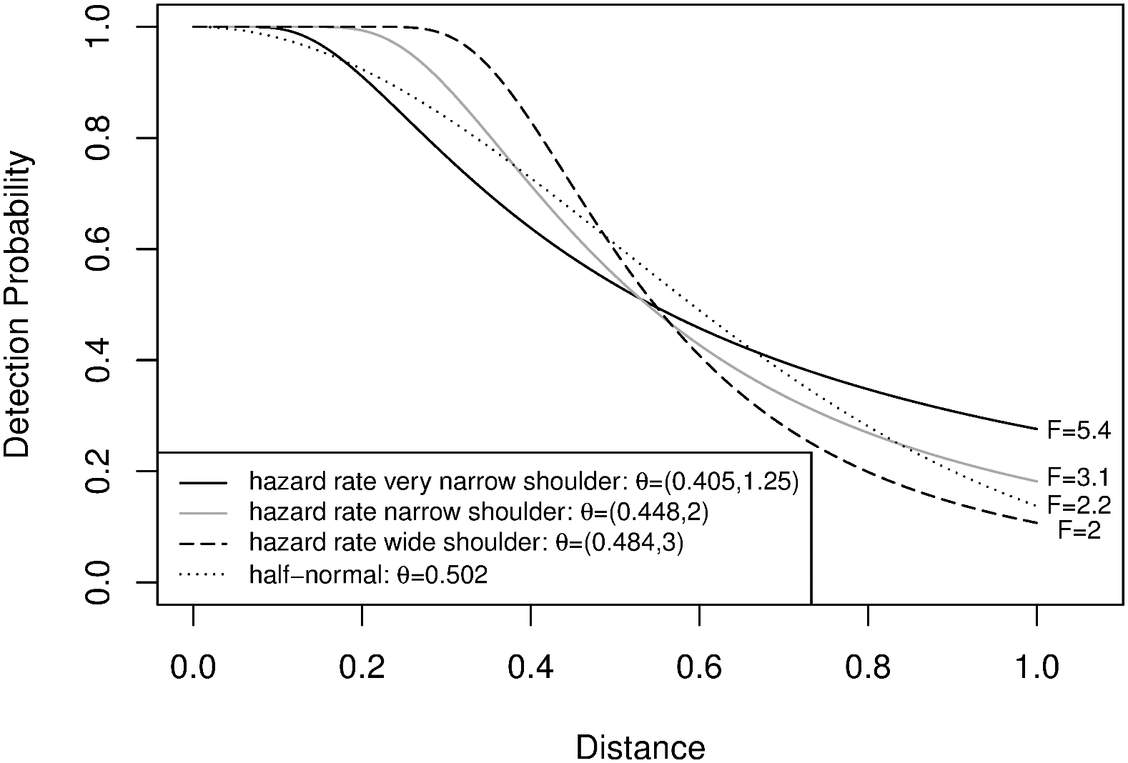
Detection functions
Clark, R.G., 2016. Statistical efficiency in distance sampling. PloS One, 11(3).

Slide 12
Selecting detection functions and detection covariates for distance sampling in ‘unmarked’

Slide 13
Modeling availability
At least two different sampling schemes
Multiple visits: N-mixture models or hierarchical distance sampling incorporate this (‘unmarked’ can do both)
Removal sampling
Chunk a point count into multiple time bins, once you hear a bird don’t count it in later time bins (thus “removing” it)
Implemented for point counts in R package ‘detect;’ can be combined with distance sampling
Covariates can include things like time of year and time of day
Combining multiple visits AND removal sampling with distance in a non-Bayesian framework is difficult (no good way to do this in R)
Reference for removal sampling in ‘detect’: Sólymos, P., Matsuoka, S.M., Bayne, E.M., Lele, S.R., Fontaine, P., Cumming, S.G., Stralberg, D., Schmiegelow, F.K. and Song, S.J., 2013. Calibrating indices of avian density from non‐standardized survey data: Making the most of a messy situation. Methods in Ecology and Evolution, 4(11), pp.1047-1058.

Slide 14
Incorporating availability covariates into hierarchical distance sampling in ‘unmarked’

Slide 15
Modeling abundance (or density)
I will focus on hierarchical distance sampling here
Given p = P(detectable), phi = P(available), a = area sampled, and d = number detected, overall abundance in its simplest form can be calculated as:
d/(phi*p)*a
With hierarchical distance sampling, abundance as a point scale is treated as a random variable and can accommodate covariates
Reference for hierarchical distance sampling: Chandler, R.B., Royle, J.A. and King, D.I., 2011. Inference about density and temporary emigration in unmarked populations. Ecology, 92(7), pp.1429-1435.

Slide 16
Abundance covariate hierarchy for my study
YEAR EFFECTS
-Species richness
-Total live tree basal area
-Total dead tree basal area
-Proportion of basal that is oak (proportion oak)
Year (categorical)
TREE CHARACTERISTICS
-Size of nearest forest patch
-Proportion forest in 1 km radius
-Proportion forest in 10 km radius
LANDSCAPE SCALE
-Shrub stem density
-% grass cover
-% leaf litter cover
-% “green” ground cover
AT OR NEAR GROUND LEVEL
EDGE EFFECTS
Distance to edge

Slide 17
Acadian Flycatcher Predictions
Forest cover at 1 km and 10 km (+)
Patch size (+)
Distance to edge (+)
Live tree basal area (+)

Slide 18
Incorporating abundance covariates into hierarchical distance sampling in ‘unmarked’
Covariate key (all numeric covariates center scaled)
year = survey year (factor)
nearest_patch_size = area of closest forest patch
fprop1km and fprop10km = proportion of land area covered by forest in 1 km and 10 km, respectively
dist_edge = distance to forest edge (before center-scaling, 0 if not in forest)
spp_rich = tree species richness in 1m factor prism sample
live_basal = basal area of all live trees in 1m factor prism sample
dead_basal = basal area of all dead trees in 1m factor prism sample
oak_prop = proportion of basal area comprised by oaks (0 if no trees)
grass_prop = proportion of ground covered by graminoids (e.g., grass)
litter_prop = proportion of ground covered by leaf litter
green_prop = proportion of ground covered by herbs or green leaves of small woody plants
shrub_dens = density of shrub stems

Slide 19
Acadian Flycatcher Results
Forest cover at 10 km (+)
Patch size (-)
Distance to edge (+)
Live tree basal area, spp. richness, proportion oak(+)
Shrub density and grass cover (-)
Litter cover (+)

Slide 20
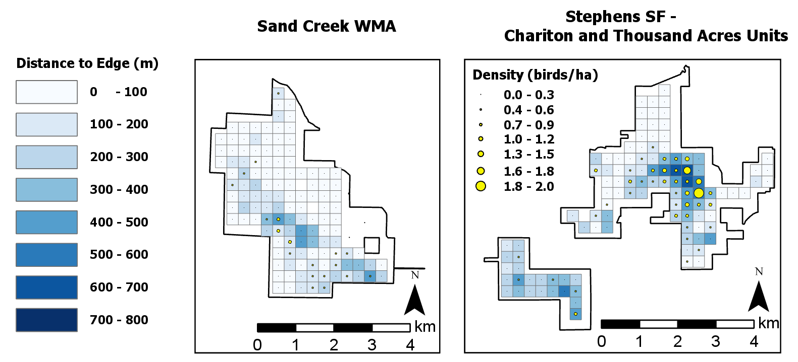
Displaying results in ArcGIS

Slide 21
Issues
Four years worth of data; 2016 had two observers that didn’t observe during any other year; makes models with observer and year difficult
Hazard function: singular Hessian (no variance/covariance matrix, so no precision estimate)
Half normal: doesn’t always fit as well as hazard, and sometimes I don’t get estimates for one of my observers
Some species are too loud for distance sampling (detectability doesn’t decline with distance); going to try N-mixture and see how that goes
Getting precision on density estimates for year-area combinations (i.e., subset points in a single year)
Data aren’t quite distributed Poisson (lower variance at a point scale)
Might try bootstrapping

Slide 22
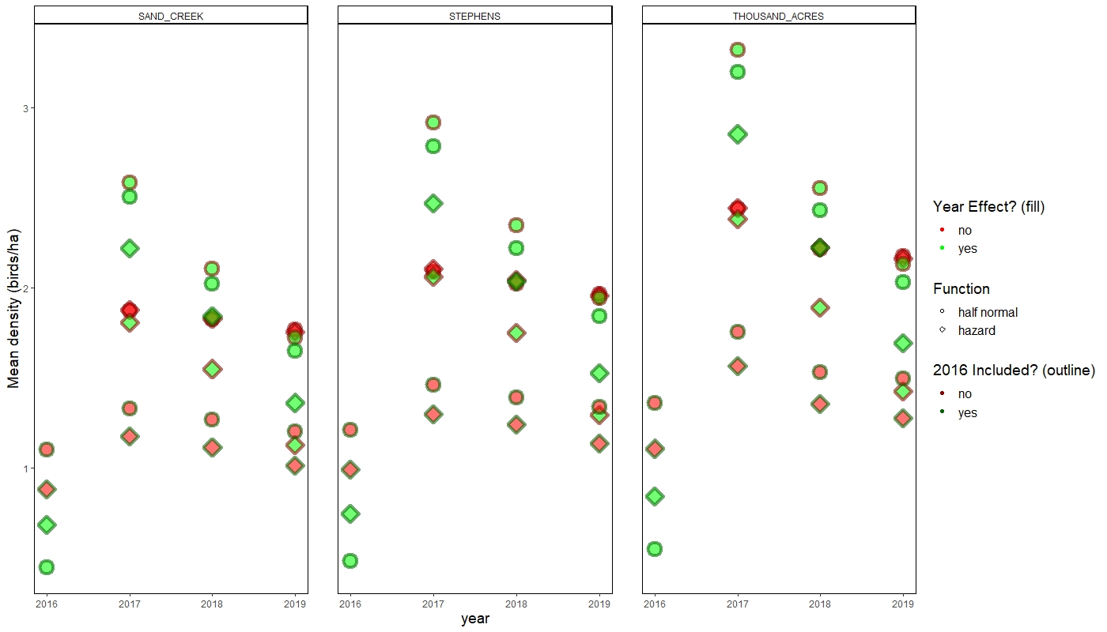
Looking at confounded observer-year effects

Slide 23
Future Directions
Adding in a midstory foliage density component to my model hierarchy
Using point-scale density estimates from a variety of species to 1st) estimate diversity at a point-scale 2nd) use those diversity estimates to determine relationships between diversity and habitat

Slide 24
Acknowledgements
U.S. Forest Service (USDA), Iowa Department of Natural Resources, and McIntire-Stennis Capacity Grant (USDA) for funding
Jesse Beck, Joe Cicero, Mark Edwards, Sonia Howlett, Connor Langan, Kevin T. Murphy, Jacob Newton, Rachel A. Vanausdall
Images: BCA Map from the Iowa Department of Natural Resources

